Slide 1

To make a Retrieval System

Slide 2

Outline
Search Engine Architecture
One Basic Information Retrieval
Boolean Retrieval System
Modification in Boolean Retrieval System
Inverted Index: Dictionary and Posting
Conclusion

Slide 3
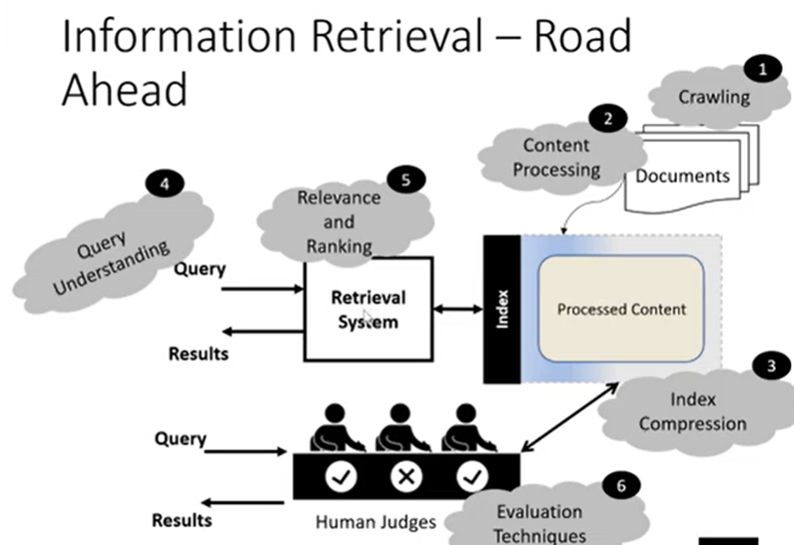

Slide 4

The problem
Query is: To find “BIT Mesra”
Collection of 5 document is available
Which document will be matched and why?

Slide 5

One Possible Solution
Match 1st term
Filter documents that contains this term
Match 2nd term
Filter documents that contains this term
Match next term
Filter documents that contains this term

Slide 6

Problem with the approach

Slide 7
Representing document as a term document incidence matrix
Documents
 | D1 | D2 | D3 | D4 | D5
BIT | 1 | 1 | 1 | 1 | 1
Mesra | 1 | 0 | 0 | 0 | 0
Patna | 0 | 1 | 0 | 0 | 0
Jaipur | 0 | 0 | 1 | 0 | 0
Lalpur | 0 | 0 | 0 | 1 | 0
Deoghar | 0 | 0 | 0 | 0 | 1
Term

Slide 8
Representing document as a term document incidence matrix
Documents
 | D1 | D2 | D3 | D4 | D5
BIT | 1 | 1 | 1 | 1 | 1
Mesra | 1 | 0 | 0 | 0 | 0
Patna | 0 | 1 | 0 | 0 | 0
Jaipur | 0 | 0 | 1 | 0 | 0
Lalpur | 0 | 0 | 0 | 1 | 0
Deoghar | 0 | 0 | 0 | 0 | 1
Term

Slide 9

Boolean Retrieval Model
The assumptions:
The conjunction operators are used in Boolean queries e.g. AND, OR and NOT to join query terms
Each document is considered as set of words
Either match or no match

Slide 10
Simple Conjunctive Queries
Query=“Brutus and Caeser
and not Calpurnia”
Results=?
Retrieval System
Collection
Shakespeare
Work

Slide 11
A Term-document Incidence Matrix Example
Documents
 | Antony & Cleopatra | Julius Caeser | The Tempest | Hamlet | Othello | Macbeth
Antony | 1 | 1 | 0 | 0 | 0 | 1
Brutus | 1 | 1 | 0 | 1 | 0 | 0
Caeser | 1 | 1 | 0 | 1 | 1 | 1
Calpurnia | 0 | 1 | 0 | 0 | 0 | 0
Cleopatra | 1 | 0 | 0 | 0 | 0 | 0
Mercy | 1 | 0 | 1 | 1 | 1 | 1
Worser | 1 | 0 | 1 | 1 | 1 | 0
Term

Slide 12
“Brutus & Caeser and not Calpurnia”
Documents
 | Antony & Cleopatra | Julius Caeser | The Tempest | Hamlet | Othello | Macbeth
Antony | 1 | 1 | 0 | 0 | 0 | 1
Brutus | 1 | 1 | 0 | 1 | 0 | 0
Caeser | 1 | 1 | 0 | 1 | 1 | 1
Calpurnia | 0 | 1 | 0 | 0 | 0 | 0
Cleopatra | 1 | 0 | 0 | 0 | 0 | 0
Mercy | 1 | 0 | 1 | 1 | 1 | 1
Worser | 1 | 0 | 1 | 1 | 1 | 0
Term
Doc 1 and Doc4 satisfy the users query

Slide 13

Disadvantage of Term Document Matrix
Addition of new column after addition of new document
Sparse Matrix

Slide 14

Idea
The world of Data Structure have the solution

Slide 15
The problem
The n dimensional vector can be represented as
An array of n element can be represented as int [] Arr={1,1,1};
So, a large vector; say 10k, can be represented by {1,1,0,0,0,…,10Kelements}

Slide 16

Solution
{1,1,0,…,10k elements} is
{0,0,1,0,1,0,0,….,10 k elemets}
1
2
3
5

Slide 17
A Term-document Incidence Matrix Example
Documents
 | Antony & Cleopatra | Julius Caeser | The Templet | Hamlet | Othello | Macbeth
Antony | 1 | 1 | 0 | 0 | 0 | 1
Brutus | 1 | 1 | 0 | 1 | 0 | 0
Caeser | 1 | 1 | 0 | 1 | 1 | 1
Calpurnia | 0 | 1 | 0 | 0 | 0 | 0
Cleopatra | 1 | 0 | 0 | 0 | 0 | 0
Mercy | 1 | 0 | 1 | 1 | 1 | 1
Worser | 1 | 0 | 1 | 1 | 1 | 0
Term
Brutus
Caeser
1
2
4
Calpurnia

Slide 18

Converting the previous example in linked list form

Slide 19
Tokenization
Task
Chop document into pieces
Throw away characters such as punctuations
Example1:
Document1:
I did enact Julius Caeser. I was killed i’ the capitol; Brutus killed me
Document2:
so let it be with Caeser. The noble Brutus hath hold you Caeser was ambitious

Slide 20
Tokenization
Caeser | 1
I | 1
Did | 1
Enact | 1
Julius | 1
Caeser | 1
I | 1
Was | 1
Killed | 1
i’ | 1
The | 1
Capitol | 1
Brutus | 1
Killed | 1
Me | 1
So | 2
Let | 2
It | 2
Be | 2
with | 2
Caeser | 2
The | 2
Noble | 2
Brutus | 2
Hath | 2
Hold | 2
You | 2
Caeser | 2
Was | 2
Ambitious | 2
Task
Chop document into pieces
Throw away characters such as punctuations
Example1:
Document1:
I did enact Julius Caeser. I was killed i’ the capitol; Brutus killed me
Document2:
so let it be with Caeser. The noble Brutus hath hold you Caeser was ambitious

Slide 21
Sort
Caeser | 1
I | 1
Did | 1
Enact | 1
Julius | 1
Caeser | 1
I | 1
Was | 1
Killed | 1
i’ | 1
The | 1
Capitol | 1
Brutus | 1
Killed | 1
Me | 1
So | 2
Let | 2
It | 2
Be | 2
with | 2
Caeser | 2
Term | DocID
ambitious | 2
Be | 1
Brutus | 1
Brutus | 2
Capitol | 1
Caeser | 1
Caeser | 2
Caeser | 2
Did | 1
Enact | 1
Hath | 1
I | 1
I | 1
i’ | 1
It | 2
Julius | 1
Killed | 1
Killed | 1
Let | 2
Term | DocID
Me | 1
Noble | 2
So | 2
The | 1
The | 2
Told | 2
You | 2
Was | 1
Was | 2
With | 2
The | 2
Noble | 2
Brutus | 2
Hath | 2
Hold | 2
You | 2
Caeser | 2
Was | 2
Ambitious | 2

Slide 22

Inverted index: Dictionary & Postings
Multiple term entries in a single document are merged
Split into dictionary and postings

Slide 23
Term | DocID
ambitious | 2
Be | 1
Brutus | 1
Brutus | 2
Capitol | 1
Caeser | 1
Caeser | 2
Caeser | 2
Did | 1
Enact | 1
Hath | 1
I | 1
I | 1
i’ | 1
It | 2
Julius | 1
Killed | 1
Killed | 1
Let | 2
Term | Doc freq
ambitious | 1
Be | 1
Brutus | 2
Capitol | 1
Caeser | 2
Did | 1
Enact | 1
Hath | 1
I | 2
i’ | 1
It | 1
Julius | 1
Killed | 1
Let | 1
Me | 1
Noble | 1
So | 1
The | 2
Told | 1
You | 1
Was | 2
With | 1
Posting List
2
2
1
2
1
1
2
1
1
Term | DocID
Me | 1
Noble | 2
So | 2
The | 1
The | 2
Told | 2
You | 2
Was | 1
Was | 2
With | 2
2
1
2
1
1
2
1
1
1
1
2
2
2
1
2
2

Slide 24
Conclusion
Document
Query=“Brutus and Caeser
and not Calpurnia”
Results=?
Indexing
Retrieval System
Collection
Inverted Index

